Slide 1

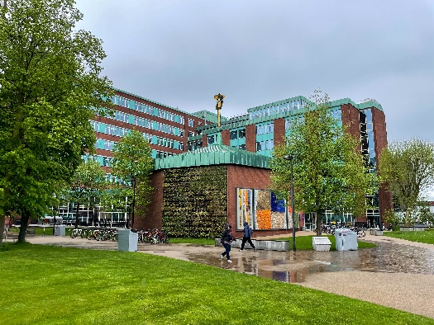
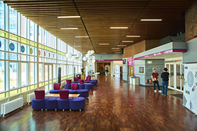

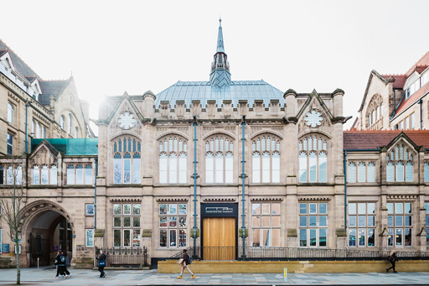
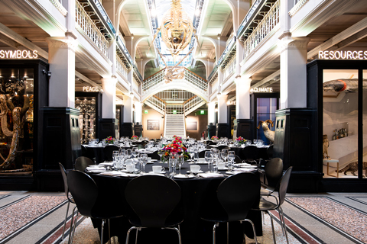
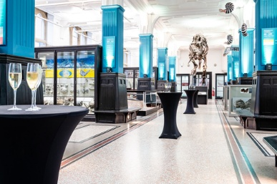
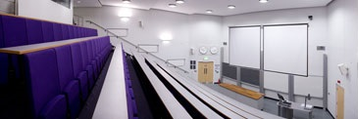
7th – 9th September 2026

Slide 2
CryoUsers has a 34-year history, it was initially a forum that bought technicians together that were operating Helium liquefiers and Helium recovery systems in universities and research establishments. This enabled them to network and share their operational experiences. The meeting has grown and now includes facility and laboratory cryogenics and is strongly supported by key industrial partners. The CryoUsers aim is to promote training, cooperation and knowledge sharing of Helium systems and Cryogenics across research establishments and industry.
CryoUsers 2026 will take place at the University of Manchester in the Schuster Building with Ensuite Halls accommodation a short walk away; Mondays evening buffet, all meals and coffee will be included.
Manchester Conferences are helping us to secure the Manchester Museum for our Tuesday evening 4 course banquet; the Museum is a short walk from the venue.
Joining instructions and Itinerary are to follow!
If you need anything else, please do not hesitate to contact us through CryoUsers@gmail.com

